Slide 1
CLOTT 3 March 2021 Monthly Project Planning Meeting
“Implementing Best-Practice, Patient-Centered Venous Thromboembolism (VTE) Prevention in Trauma Centers”

Slide 2
Participating Sites
Participating Trauma Centers
University of Maryland
2. Oregon Health & Science University
3. Medical College of Wisconsin
4. Stanford University
5. UC San Diego
6. University of California San Francisco
7. University of Utah
8. Medical University of South Carolina
9. Penn Medicine- Lancaster General Hospital
10. Christiana

Slide 3
Contracting, IRB, DUA
Site Name | Contract Status | IRB Status | DUA Status
UC San Diego | Executed | Approved | Review in progress
Lancaster General | Executed | Submitted | Complete
University of Maryland | Executed | Approved | Review in progress
University of California San Francisco | In Progress | Submitted | Will submit when IRB approved
Medical College of Wisconsin | Executed | Submitted | Review in progress
Stanford University | In Progress | In Progress | Review in progress
University of Utah | Executed | Submitted | Review in progress
Medical University of South Carolina | Executed | Submitted | Review in progress
Oregon Health & Science University | Executed | Submitted | Complete
Christiana Hospital | In Progress | In Progress | In Progress

Slide 4
Data Use Agreements
The DUA will be between your organization and Johns Hopkins University.
You should have already been contacted by JHU for data use agreement
Will not be de-identified data set
Needs some PHI

Slide 5
Milestones (need to complete)
MILESTONE NAME | DESCRIPTION | DUE DATE | COMPLETED DATE | MILESTONE STATUS | REASON FOR DELAY
IRB approvals | Obtain IRB and data sharing agreements for all participating sites, including for trauma registry data and missed doses from the EHR. | 12/31/20 |  | Delayed | IRB delay
Real-time Alert Build | Finalize real-time EHR alert system at all implementation sites | 2/28/21 | - | Delayed | Other
Data Collection (Pre-Implementation) | Receive pre-implementation data collection across all implementation sites. This includes trauma patient admissions, demographics, injury characteristics, length of stay, outcomes, complications, VTE events (from trauma registries) and VTE missed doses from EHR. | 2/28/21 | - | Delayed | IRB delay
Missed Doses Data Pull | Work with IT to program data pull for missed doses of VTE prophylaxis | 2/28/21 | - | Delayed | Other
Trauma Registry Data Pull | Agreement with implementation sites to allow access to trauma registry patient data | 2/28/21 | - | Delayed | IRB delay
Nurse Education Complete | Nurses trained/education completed; modules will remain open for new hires/transfers of staff | 2/28/21 |  | Delayed | Awaiting IRB approval.
Nurse Education- Peer Coaching | Begin peer coaching (JHU nurse educators to teach other nurses approaches to educating patients) | 2/28/21 | - | Delayed | Awaiting IRB approval.
Patient-centered Education Intervention | Initiate patient education bundle at first trauma center; the project team will conduct a site visit (in person, or virtual) following program launch at each center. | 2/28/21 | - | Delayed | Awaiting IRB approval.

Slide 6
Real Time Alert Build, IT, Data Collection
Alert workflow
Hospital VTE prophylaxis formulary
Epic Report Writer to modify query for VTE prophylaxis registry and append encounter number to trauma registry data
Preferred communication device to receive real-time alert
Epic Builder to modify/implement real-time alert

Slide 7
Nursing Education Roll Out
We will provide FAQ sheet and login information to access the education module
Each site will receive a specific code
You will be asked to:
Assign the module to all the nurses
Ensure they take the online education
Allow one month for completion

Slide 8
CLOTT 3 Website
https://www.nattrauma.org/research/clott-3-project-page/
What other information would be helpful to include on the website?

Slide 9
Education Materials
Working on finalizing education materials (posters, badge cards)
CNTR will print and ship to each site

Slide 10
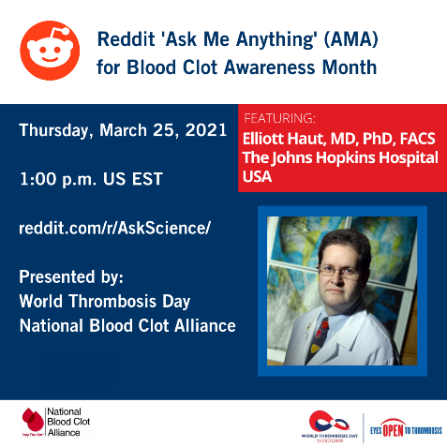
Blood Clot Awareness Month #BCAM
https://www.hopkinsmedicine.org/armstrong_institute/improvement_projects/infections_complications/VTE/symposium.html
https://raceroster.com/events/2021/38192/team-stop-the-clot-presents-the-100000-reasons-ride
https://www.reddit.com/r/askscience/

